Slide 1



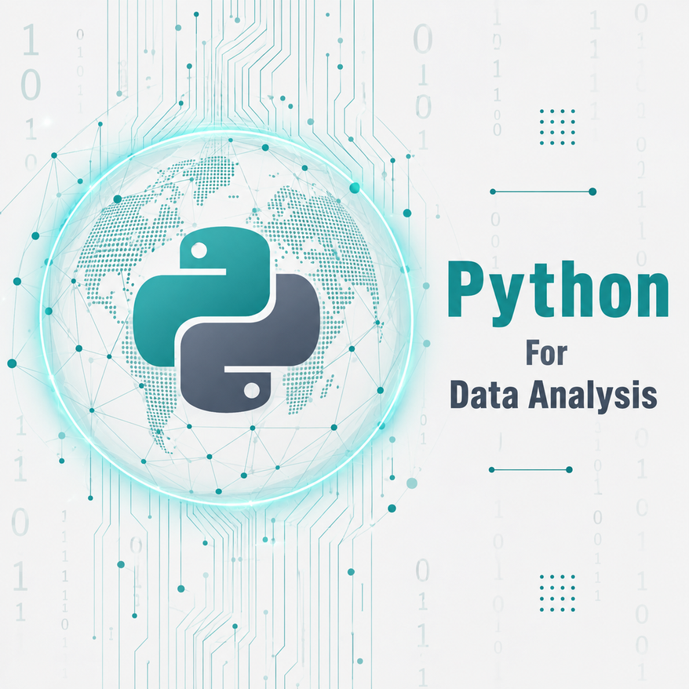



DATA ANALYSIS
Module 5: Python for Data Analysis
AI-Assisted Coding
Topic 4 of 4

Slide 2


Module Objectives
Introduce learners to the use of AI assistants for coding and data-analysis tasks.
Develop learners’ ability to write effective prompts that provide AI with clear data,
objectives, and coding requirements.
Develop learners’ ability to review, test, debug, and verify AI-generated code before
using it in their analysis.
Promote responsible use of AI in data analysis, including understanding code, protecting sensitive information, and taking responsibility for submitted work.

Slide 3


Learning outcome
By the end of this topic, the trainee can…
1- Use AI assistants to generate, explain, and debug Python and pandas code for data-analysis tasks.
2- Evaluate and verify AI-generated code by checking its syntax, columns, logic, outputs, and alignment with the original analytical question.
3- Identify and correct AI-generated errors and hallucinations, including incorrect functions, column names, assumptions, and logical errors.
4- Explain and take responsibility for AI-assisted code by understanding every line before running, submitting, or using it in an analysis.
Notes:
1.7.2013
‹#›

Slide 4
What AI Can and Cannot Do
AI CAN
AI CANNOT REPLACE
Generate code
Analytical judgment
Explain code
Data validation
Suggest alternatives
Output verification
Debug errors
Understanding
Help interpret syntax
This module isn't about avoiding AI. It's about staying the one who's responsible for the answer.
Notes:
1.7.2013
‹#›

Slide 5
The AI-Assisted Coding Workflow
Define
problem
Write
prompt
Generate
code
Read
code
Run
code
→
→
→
→
Check
output
Verify
result
Explain
code
Submit
→
→
→
Non-negotiable: copying code you can't explain is not submission-ready, no matter how correct the output looks. "Read code", "Verify result" and "Explain code" are not optional steps you skip when you're in a hurry.
Nine steps, but only three involve AI at all: write prompt, generate code, and optionally ask for an explanation. The rest is you.

Slide 6
Weak vs Strong Prompts
WEAK PROMPT
STRONG PROMPT
PROMPT
PROMPT
"Write pandas code."
I have a pandas DataFrame `df` from branch_sales.csv with columns: Branch, Region, Sales, Cost, Profit, Price. Write code that filters transactions where Sales is above 100000, groups the result by Region, and shows total Sales and total Profit per region. Use only boolean filtering, groupby and sum. I expect a small table with 3 rows, one per region.
No dataset, no columns, no goal
AI has to guess everything, including what "pandas code" should even do
Guessed assumptions are where hallucinations start
Dataset structure — "a pandas DataFrame df from branch_sales.csv"
Column names — "Branch, Region, Sales, Cost, Profit, Price"
Analytical objective — "filters... groups... shows total Sales and Profit"
Expected output — "a small table with 3 rows, one per region"
Constraints — "use only boolean filtering, groupby and sum"

Slide 7
Prompting AI for pandas
USER PROMPT
AI-generated
My DataFrame df has columns Branch, Region, Sales, Profit. Write pandas code to filter transactions with Sales above 100000, then group by Region and sum Sales and Profit.
high_value = df[df["Sales"] > 100000]
result = high_value.groupby("Region")
[["Sales","Profit"]].sum()
result
Human review: Sales and Profit and Region are real column names in df.columns. Sales > 100000 matches what "high value" means here. Grouping by Region matches the question, not Branch.
OUTPUT
Region Sales Profit
North Central 399000 59850
North West 345000 51750
South West 711000 106650
The code is only "final" after it's read and checked against the question, not the moment it runs without an error.

Slide 8
Ask AI to Explain Code
PROMPT
"Explain this pandas code line by line as if I am a beginner data analyst:" high_value = df[df["Sales"] > 100000] · result = high_value.groupby("Region")[["Sales","Profit"]].sum()
high_value = df[df["Sales"] > 100000]
Keeps only the rows where Sales is more than 100,000, and stores that smaller table as high_value.
.groupby("Region")[["Sales","Profit"]].sum()
Groups those rows by Region, then adds up Sales and Profit within each group.
result
Displays the final summary table, one row per region.
Still verify it yourself: an explanation is a draft, not a verdict. Check it against something you already know: does the row count and totals match what you computed in Module 5.3?

Slide 9
AI-Assisted Debugging
THE BROKEN CELL
AI'S CORRECTION, VERIFIED
AI replies: pandas column names are case-sensitive. Your DataFrame has a column called "Region" (capital R), not "region". Use df.groupby("Region")["Sales"].sum().
df.groupby("region")["Sales"].sum()
KeyError: 'region'
PROMPT SENT TO AI
df.groupby("Region")["Sales"].sum()
I got this error: KeyError: 'region', from running df.groupby("region")["Sales"].sum() on a DataFrame whose columns are Branch, Region, Sales, Cost, Profit, Price. What's wrong?
OUTPUT
North Central 546000
North West 537000
South West 1032000
Send the full error message and the exact code, not "it doesn't work". Vague reports get vague answers.

Slide 10
Verify AI-Generated Code: A Checklist
✓
1. Does the code run?
✓
2. Does it use the correct columns?
✓
3. Does the output make sense?
✓
4. Does the result answer the original question?
✓
5. Can I reproduce the result another way?
✓
6. Can I explain every line?
Six short questions, every time, on every piece of AI-generated code before it goes anywhere near a submission.

Slide 11
AI Hallucinations and Incorrect Code
AI can produce incorrect syntax, non-existent functions, wrong column names, incorrect assumptions, or logically incorrect analysis, all delivered in the same confident tone as correct code.
A FUNCTION THAT DOESN'T EXIST
A COLUMN THAT DOESN'T EXIST
df.sort("Sales", ascending=False)
df["Amount"].sum()
AttributeError: 'DataFrame' object
has no attribute 'sort'
KeyError: 'Amount'
AI recalled an old pandas method removed years ago. The fix is sort_values(), taught in Module 5.3.
AI guessed a common column name from other datasets it has seen. This dataset calls it Sales.
Both mistakes are caught the same way: run the code, read the message, and check df.columns before trusting any column name AI suggests.
A LOGICAL ERROR THAT RUNS FINE
df["Margin_%"] = df["Profit"] / df["Sales"] * 100
avg_margin = df["Margin_%"].sum()
print(avg_margin) # 300.0
No error, no traceback, code runs perfectly. sum() adds every row’s margin instead of averaging them. An average per-transaction margin of 300% is impossible — only checking whether the output makes sense catches it. Fix: .mean() instead of .sum() → 15.0.

Slide 12
Privacy and Responsible AI Use
Avoid sending an AI tool anything you wouldn't want stored on someone else's server:
Personal information
Passwords
API keys
Confidential business information
Sensitive datasets
Why branch_sales.csv is safe to paste anywhere: every customer in it, Sunrise Stores, Coastal Mart, and the rest, is a fictional business name. No real client or personal data ever needs to touch an AI tool for this course to work.
Working with real company data on the job? Anonymise it or use a small representative sample before it goes anywhere near an AI tool.

Slide 13
The “Explain It Back” Rule
If you cannot explain the code, you cannot submit the code.
PAIRED ACTIVITY
1
Partner A explains the code, line by line, out loud
2
Partner B asks questions, especially about any line that sounded rehearsed rather than understood
3
Swap roles with a different piece of code
4
Any line neither partner can explain must be investigated before submission, not waved through

Slide 14
Good vs Bad AI-Assisted Analysis
BAD
GOOD
Ask AI → Copy code → Submit
Define → Prompt → Review → Run → Verify → Explain → Submit
Errors ship silently, hidden inside a working-looking output
Every step is a checkpoint where a mistake gets caught early
You can't defend your own analysis in review or on the capstone panel
You can defend every line to a manager, a peer, or a panel judge
One wrong assumption from AI becomes your wrong conclusion
AI made you faster, it didn't make you less responsible
Same tool, same AI assistant, two completely different outcomes. The difference is entirely in the steps you refuse to skip.

Slide 15
Key Takeaways
Write clear and specific prompts
Review and understand AI-generated code
Test and verify results before submission
Use AI responsibly and protect sensitive data

Slide 16
Practical Challenge: AI-Assisted Analysis
Business question: on branch_sales.csv, which branch has the highest average Sales among transactions above ₦80,000, and which single transaction is the most profitable company-wide?
1
Write the analytical question in your own words
2
Ask an AI assistant for help generating the code
3
Review the generated code before running anything
4
Run it in Google Colab
5
Verify the result against the checklist from this session
6
Explain every line, then submit with a short note on how AI was used
Reflection: "What part of the analysis did AI help with, and what part still required your judgment?"

Slide 17

Key Takeaways
Five key primitives: string, number, boolean, null, and undefined.
Quotes matter: Strings need them; numbers fail with them. Mixing them causes major bugs.
Up Next:
Arithmetic & Operators
Booleans are logical: Use them for true/false states, never wrap them in quotes.
Empty states: Use null for intentional emptiness; undefined is the "missing" default.
The Inspection Tool: Use typeof to verify data types while coding.
Notes:
1.7.2013
‹#›

